Slide 1
IT Department

Slide 2
Evolution in the systems
Manual Work
Introduction of the PC Based Systems
Centralized Processing
Client Server Environment
Web Applications
Mobile Apps
Integrated Solutions

Slide 3
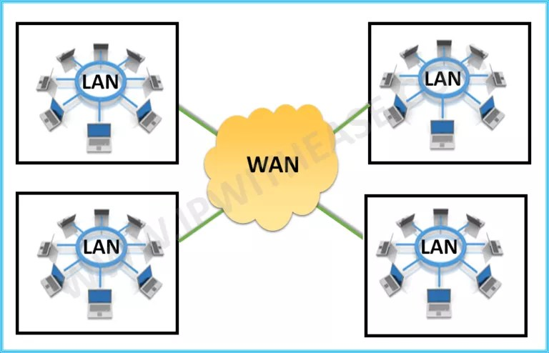
What Is LAN and WAN
Local Area Network, is a network that covers a small geographical area such as our office premises in same location or same building. In other words it is the collection of wired and Wi-Fi connected devices in your home or office.
Wide Area Network, is a network that covers larger geographical areas that can span the globe.

Slide 4
Advantages of Web technology
Using web technology as well as mobile technology, we are easily available globally due to which the ease of doing business has increased.
But what are the threats ???????

Slide 5
Threats due to internet technology
Information theft and its misuse
Hacking of the IT systems through malware / virus
Ransom ware
Phishing
Spyware and many more challenges and tricks are used day by day.
Usage of unauthorized applications

Slide 6
Need to protect our system from all types of threats.
We are providing Electricity & Transportation
services to Mumbai City, the financial capital of India.
The Undertaking’s data may be leaked / misused which will affect our services and may cause to paralyzing the city.

Slide 7
What is cyber security
Cyber security is the practice of defending computers, servers, mobile devices, electronic systems, networks, and data from malicious attacks.
Cyber Security is applicable to all the information assets/infrastructure, information technology and operational technology systems.

Slide 8
Policies for cyber security
Ministry of Power has issued the various guidelines to all the Electricity Discoms in the Country to protect their Critical Information Infrastructure ( CII ) which may lead to destroy the nation level security.
All the persons including our employees and outside agencies having directly or indirectly access to our systems should required to adhere the Cyber Security policies strictly and ensure compliance.
The various guidelines from Ministry of Power, GoI, GoM are issued time to time.
It is mandatory for Undertaking to make the compliance of these guidelines.

Slide 9
First Steps towards compliance of this orders
Start controlling the access of information to all the employees and stakeholders who are accessing the data.
To form the centralized controlling infrastructure in order to control the access of information.
Control and monitor the PC based activities
Install the licensed software's as per the precise user requirement.
Avoid using the unauthorized software
Avoid visiting unnecessary websites
Make the necessary alterations in your PC functionality and system security settings.

Slide 10
Implementation of the Active Directory
Introduction to networking project
What is active directory
Its features
Advantages
Data Requirement from User Department

Slide 11
Questions and Answers

Slide 12
Thank You

